Slide 1
Introduction to Medication Assisted Treatment
Ken Martz, Psy.D. CAS
Special Assistant to the Secretary
Pennsylvania Department of Drug and Alcohol Programs

Slide 2
Why does one become addicted?
Causes
Biology
Genes, Biochemistry, Brains, Autopilot Learning
Relationships with Others
Peer Pressure, Family, “Enabling”, Isolation, Lies
Relationship with Self
Shame, Guilt, Negative Beliefs,
“Hate Self”
Relationship with Higher Power
Lack of Connection with Personal Values,
Anger/Shame with God

Slide 3
Why does one become addicted?
Causes | Solutions
Biology Genes, Biochemistry, Brains, Autopilot Learning | Medication, Meditation Exercise, Diet, Sleep, Stress Management Decisional Actions
Relationships with Others Peer Pressure, Family, “Enabling”, Isolation, Lies | Limit Setting, Relationship Building, Honesty, Clear Communication Family/Couples Therapy Positive Peer Pressure
Relationship with Self Shame, Guilt, Negative Beliefs, “Hate Self” | Forgive Self, Gratitude Practice Engage in Healthy Behaviors Today Healthy Coping Skills Training
Relationship with Higher Power Lack of Connection with Personal Values, Anger/Shame with God | Define Values, Live by Personal Values Pray, Meditate, Other Spiritual Practice

Slide 4
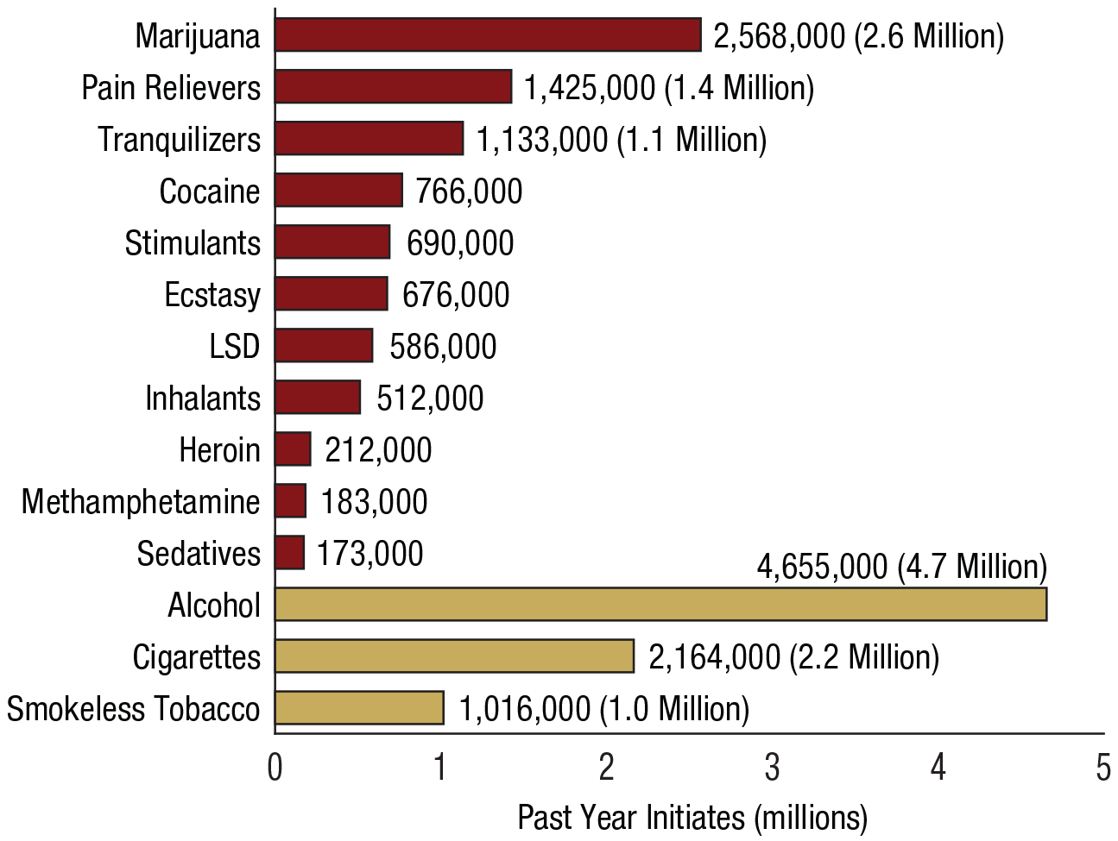
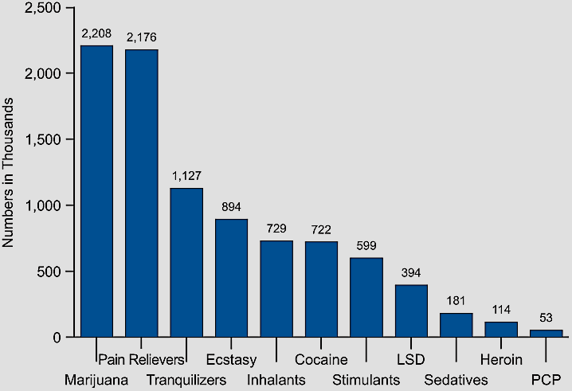
Overview of Substance and Drug Use
Past-Year Initiates for Specific Illicit Drugs Among Persons Age 12 or Older, 2014
Past-Year Initiates for Specific Illicit Drugs Among Persons Age 12 or Older, 2008
Source: Substance Abuse and Mental Health Services Administration. (2009). Results From the 2008 National Survey on Drug Use and Health: National Findings Rockville, Maryland.

Slide 5
Available NTPs and Overdose Deaths in Pennsylvania

Slide 6
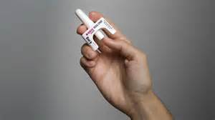
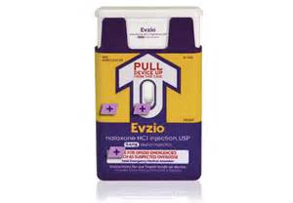
Naloxone and Act 139
How do I get naloxone?
  Family members and friends can access this medication by obtaining a prescription from their family doctor or by using the standing order (a prescription written for the general public, rather than specifically for an individual) issued by Rachel Levine, M.D., PA Physician General.
What types of naloxone are available?
  Nasal Spray (Narcan by Adapt Pharma)
  Auto Injector (Evzio by Kaleo)
Is additional training available?
  Training is available at one of the Department of Health approved training sites www.getnaloxonenow.org or https://www.pavtn.net/act-139-training.

Slide 7

Naloxone Reversals By Police Officers In Opioid Overdose Events
Number of successful overdose reversals per county
Single asterisks * signify counties with zero PDs carrying naloxone however preparing to launch naloxone programs within the next few months.
Municipal Police Reversals = 1,128
PA State Police Reversals = 36
TOTAL REVERSALS = 1,164
Erie
11
Tioga
Susquehanna
Warren
McKean
Potter
0
Bradford
*
Crawford
*
Wayne
*
1
Forest
Wyoming
Elk
0
Lackawanna
Venango
*
Cameron
Lycoming
Sullivan
26
Mercer
Clinton
*
Pike
0
Clarion
*
Luzerne
0
Jefferson
Columbia
11
Lawrence
0
Clearfield
Union
1
Monroe
*
Butler
*
Centre
0
Montour
Carbon
0
8
1
Northumberland
22
Beaver
Armstrong
Snyder
2
Northampton
*
1
Indiana
Schuylkill
Lehigh
18
2
Mifflin
8
4
Allegheny
Cambria
Blair
Juniata
Dauphin
24
*
0
Perry
14
Lebanon
Berks
Bucks
Westmoreland
3
13
84
Washington
3
Huntingdon
Montgomery
41
Cumberland
70
10
Lancaster
York
62
Chester
Fayette
Somerset
Bedford
Fulton
Franklin
197
62
260
Philadelphia
Greene
*
20
Adams
1
Delaware
132
Rev 07/25/2016

Slide 8
Progression of a Disease and Recovery
Prevention
(Relapse)Prevention
No addiction
Late Recovery
Outpatient Treatment
Give to others
Optimism
Regain job
Face problems
Honesty
More relaxed
Relationships improve
Begin to develop trust
Resolve legal issues
Self respect returning
Connect with sponsor/
positive peer group
Self examination
Medical stabilization
Thinking begins to clear
Desire for help
No drinking
Social drinking
Drinking feels good
Drink to relax
Drink to escape
Withdrawal from friends
First DUI
Conflict in relationships
Missed time from work
Regular drinking
Amount of drinking increases
Drink to stop feeling bad
Disciplinary action at work Association with negative peer group
Antisocial beliefs justify behaviors
Increasing health complications
Relationship isolation/ alienation
Early Addiction
Middle Recovery
Intensive Treatment
Middle Addiction
Early Recovery
Late Addiction
“Rock Bottom”, Arrests
Divorce, Loss of Job
Depression,
Hopelessness,
Suicide, Death

Slide 9
SBIRT
Evidence Based Practice
Screening
    Brief Intervention
        Referral to Treatment
Often completed in medical settings such as primary care and emergency department
In workplace settings this can occur at events such as Depression Awareness day, Gambling Awareness Week, or Recovery Month events.
In the context of Workers Compensation, this continuum can be expanded to include Completion of Treatment/Return to Work
There are certain research based things to look for regarding successful completion of treatment.

Slide 10
Referral to Treatment
Actively assisting patients with appropriate treatment and linkages to recovery support for patients who require more extensive treatment and access to specialty care.
If they refuse a referral:
Treat with respect
Provide material for followup
S B I R T

Slide 11
Process for Treatment Referral
Assessment ⇨ Referral
Adults and adolescents must first be assessed to determine the appropriate level of treatment.
Once the appropriate level of treatment is determined, a referral can be made to a facility with those services.
Patients may also need to be referred for treatment for other mental and physical health problems.

Slide 12
What is the SCA?
SCA stands for Single County Authority for Drug and Alcohol.
SCAs plan, coordinate, programmatically and fiscally manage and implement the delivery of drug and alcohol prevention, intervention, and treatment services at the local level.
Provide resources to aid in referral to treatment for drug and alcohol addiction.
Manage assessment and treatment services for those who don’t have private insurance.
Additional information about your local SCA can be found at:
http://www.pacdaa.org
http://www.ddap.pa.gov

Slide 13
Treatment Assessment
Levels of Care
  Outpatient
  Intensive Outpatient
  Partial Hospitalization
  Medically Monitored Short/Long Term Residential
  Medically Managed Inpatient Residential (Hospital)
  Detoxification (Medically Monitored or Medically Managed)
Special Populations
  Medication Assisted Treatment
  Co-Occuring Mental Health Disorders
  Women and Women with Children
  Criminal Justice
  Sexual Orientation/Gender Identity
  Gambling Disorder

Slide 14
Treatment Works: But what is treatment?
Treat addresses a wide range of clinical issues that cause and exacerbate risks of substance abuse.
  These include the needs for habilitation and rehabilitation, including vocational supports, addressing trauma, learning coping skills, learning relapse prevention skills, improving relationships etc.
This is not to be confused with supporting services such as detoxification, medications, peer supports, 12-step programs, housing and other similar approaches which complement the core treatment program.
Notes:
_______________________________________________________
_______________________________________________________
_______________________________________________________
_______________________________________________________
_______________________________________________________
_______________________________________________________
_______________________________________________________
_______________________________________________________

Slide 15
Cognitive Therapy
In CBT, Behaviors are motivated by beliefs
Behavioral change is made by changing the belief patterns
  Police car example.
Examples of Addiction Generating Beliefs
  I can’t do anything else.
  I need it.
  I can’t survive without the (drug).
  I tried, but I’m not able to do it (terminally unique).
  It is easier to avoid than to face life's difficulties and self-responsibilities.
  I must have certain and perfect control over things.
Notes:
_______________________________________________________
_______________________________________________________
_______________________________________________________
_______________________________________________________
_______________________________________________________
_______________________________________________________
_______________________________________________________
_______________________________________________________

Slide 16
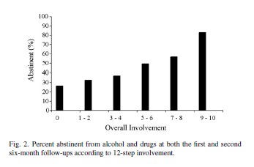
Peer Supports
Increasing attendance at 12-step meetings following treatment are associated with increased rates of abstinence (Timko & DeBenedetti, 2007).
  This includes a range of activities such as attendance, getting a sponsor, being a sponsor, reading at meetings, calling a 12-step member for help etc.
Notes:
_______________________________________________________
_______________________________________________________
_______________________________________________________
_______________________________________________________
_______________________________________________________
_______________________________________________________
_______________________________________________________
_______________________________________________________

Slide 17
Recovery Lessons Learned
Faces and Voices of Recovery Survey of 3,200 individuals with an average of 10 years in recovery.
Personal Descriptions:
  The majority (75%) selected “in recovery”;
  14% chose “recovered,”
  8% “used to have a problem with substances and no longer do,”
  3% chose “medication-assisted recovery.”
Paths to Recovery:
  71% professional addiction treatment
  18% had taken prescribed medications (e.g., buprenorphine or methadone).
  95% had attended 12-step fellowship meetings (e.g., Alcoholics Anonymous),
  22% had participated in non-12-step recovery support groups (e.g., LifeRing, Secular Organizations for Sobriety (S.O.S.).

Slide 18
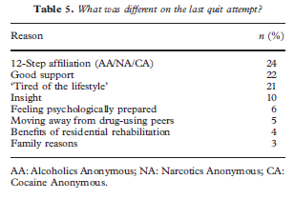
Recovery Lessons Learned
(Best et al. 2008)

Slide 20
Treatment Benefits
Ettner, et al., 2006

Slide 21
Warm Handoff Overview
Problem: When an addicted individual is ready for treatment, they don’t know where to go and how to access the system.
Solution: Support is there to connect them to the proper system resources, just like other serious medical conditions.

Slide 22
Elements of the Warm Handoff
Client
Medical Providers
SUD Treatment
County Drug and Alcohol Agency (SCA) helps ensure active funding stream (e.g. Medicaid, county funding, etc)
Their role is to identify payment sources, to complete an initial assessments, and to connect individuals to treatment
DDAP has led efforts to address each of these areas, with specific action steps.

Slide 23
Evidence Based Practice
Warm handoff procedures are evidence based as an effective approach with substantial research support
  O'Neil, S. H. (2009). Addiction treatment providers needed for 'warm handoff' from EDs. Alcoholism & Drug Abuse Weekly, 21(38), 1-3.
  Koenig, C. J., Maguen, S., Daley, A., Cohen, G., & Seal, K. H. (2013). Passing the baton: A grounded practical theory of handoff communication between multidisciplinary providers in two department of veterans affairs outpatient settings. Journal of General Internal Medicine, 28(1), 41-50.
  Boudreaux, Edwin D., Haskins, B., Harralson, T., & Bernstein, E. (2015) The remote brief intervention and referral to treatment model: Development, functionality, acceptability, and feasibility, Drug and Alcohol Dependence, 155(1), 236-242.
  Sammer, J. (2015). Warm handoffs serve as the first step toward accountable care. Behavioral Healthcare, 35(3), 24-27.
  Bernstein, E., Ashong, D., Heeren, T., Winter, M., Bliss, C., Madico, G., & Bernstein, J. (2012). The impact of a brief motivational intervention on unprotected sex and sex while high among drug-positive emergency department patients who receive STI/HIV VC/T and drug treatment referral as standard of care. AIDS and Behavior, 16(5), 1203-16.
  Bernstein, S. L., & D'Onofrio, G. (2013). A promising approach for emergency departments to care for patients with substance use and behavioral disorders. Health Affairs, 32(12), 2122-8.

Slide 24
Models of Warm Handoff
DDAP conducted a survey of existing practices in Pennsylvania, in other states, and the literature to identify best practices. Key models are:
  SUD Professional Models: The SCA, their designee or treatment provider, offer immediate access to screening, assessment and referral.
  Recovery Models: Certified Recovery Specialists or volunteers from the recovery community (e.g. peer support groups) staff emergency rooms or phone lines at key times to help transition patients to SUD treatment.
  Hospital Based Models: Hospital staff coordinate referrals similar to the process done with other acute medical conditions such as transfers to nursing homes and physical rehabilitation.

Slide 25
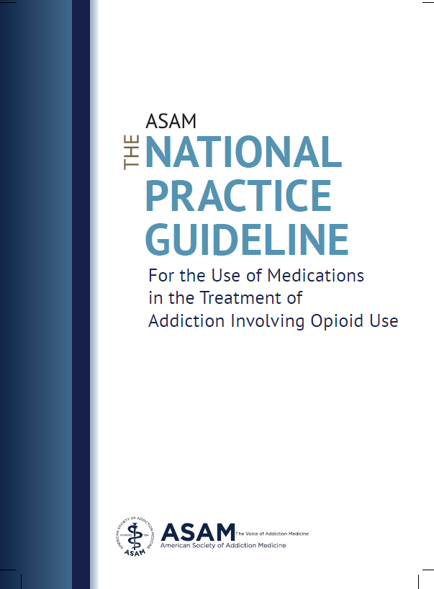

Slide 26
Points to Remember
Key points:
The choice of available treatment options for addition including opioid use should be a shared decision between the clinician and patient
Consider past treatment history, and treatment setting when deciding on medication.
Psychosocial treatment should be implemented in conjunction with medication (on site or with referral)
Diversion Control
  For methadone: Monitor consumption
  For buprenorphine: Frequent office visits, pill counts, specific drug testing for buprenorphine
Drug testing
  Monitor for prescription/illicit substances
Use of PDMP: Especially consider other opioid use and benzodiazepines

Slide 27
Overview of Medications for Opiate Assisted Treatment
 | Methadone | Buprenorphine | Naltrexone | Vivitrol
Pro | Prevents withdrawal symptoms Decreases risky behavior Decreases criminality Allows counseling Promotes access to medical/psychiatric care Promotes rehabilitation Treatment retention Cost as low as $5 per week Dose: Most patients receive 80-125mg/day but some receive as much as 325mg/day | Less tightly controlled than methadone Lower potential for abuse and are less dangerous in an overdose Progress in therapy may allow for a take-home supply of the medication Prevents Withdrawal Prevents “Craving” Does not produce a “High” when taken as directed Blocks or reduces the effect of heroin Fewer transportation issues Better compliance than methadone Dosing every 2-3 days or longer | No opiate effect “benefits” (i.e. high) More limited side effects Helps manage cravings/ relapse risk Benefits found for multiple addictive behaviors including opiates, alcohol and gambling disorders | Used to treat alcoholism and heroin addiction Monthly injections block the brain’s ability to get intoxicated or high Prospective clients must be sober for at least 7 days prior to beginning treatment Has other side effects like other medications Improved compliance
Con | Diversion potential Abuse Potential Does not address the effects/use of other substances (e.g. alcohol or benzos) Daily dosing requirements Transportation issues for daily dose Intense withdrawal from medication | Diversion potential Higher cost Does not address the effects/use of other substances (e.g. alcohol or benzos) Intense withdrawal from medication Note: Suboxone consists of a combination of Buprenorphine and Naloxone | Possible dysphonic effects High non-compliance rates (self administered, so it is easy to stop) Early gastrointestinal discomfort | Expensive for those without insurance coverage ($800-1200/month avg.) High Cost Exclusionary criteria such as liver disease Client choice/desire to choose medications that would not prevent “high”

Slide 28
Overview of Medications for Opiate Assisted Treatment
 | Methadone | Buprenorphine | Naltrexone/ Vivitrol
Contraindications and cautions | Hypersensitivity to methadone Respiratory depression Acute bronchial asthma Known or suspected paralytic ileus (intestinal blockage) | Hypersensitivity to buprenorphine or naloxone Respiratory depression Physiologically dependent on opioids and not in withdrawal prior to first dose | Acute hepatitis or liver failure Opioid analgesics needed for pain control Physiologically dependent on opioids prior to first dose Hypersensitivity to naltrexone or other components of the injection

Slide 29
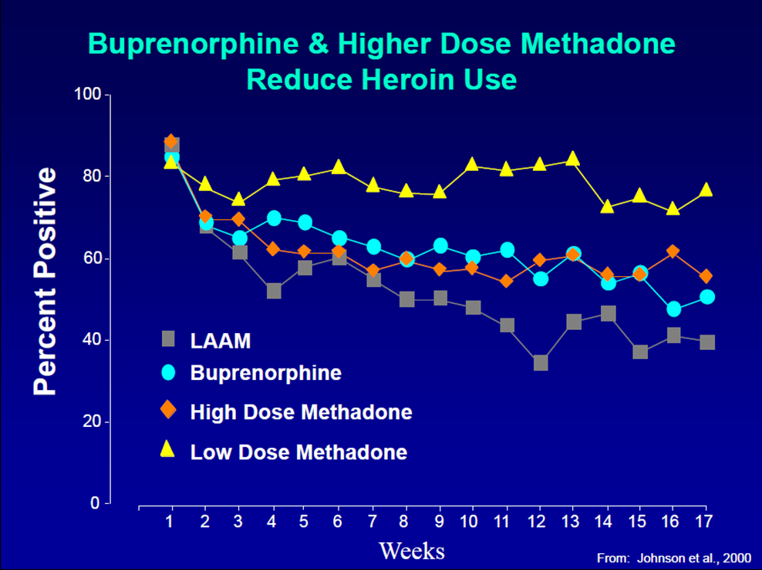

Slide 30
Medication compliance
Johnson et al, 2000

Slide 31
Buprenorphine in Pennsylvania
A 2015 review of Medicaid claims revealed:
  Only 60.1% of enrollees with buprenorphine use received at least one urine drug screen,
  Only 41.0% had behavioral health counseling services,
  34.7% had other opioid claims,
  38.0% had other benzodiazepine claims

Slide 32
Action Steps
Client Presents
Screen for SUD
          May be initiated by embedded staff or collaborations (eg. nurse, peer specialists, collaborations with SUD treatment providers etc.)
      Based on positive screening results, provide intervention or referral to treatment
          Use motivational enhancement language to engage
Screen for medication interactions
      Check PDMP
Followup care
      Use warm handoff and referrals to appropriate care:
        Assessment for level of care and specialty service
      Where appropriate, co-prescribe naloxone
      Provide information on safe medication storage and disposal
For difficult cases/ cases not responding to treatment as expected, check for SUD.
For patients at risk of addiction use caution with all potentially addictive medications (consider opiates, stimulants, benzodiazepines etc.). Consider alternatives. Consider safety of dosage practices.

Slide 33
Contact Information
Ken Martz, Psy.D. CAS
Special Assistant to the Secretary
Pennsylvania Department of Drug and Alcohol Programs
02 Kline Village
Harrisburg, PA 17104
KeMartz@pa.gov
(717)783-8200

